Slide 1
Predicting Rental Values of Owner-Occupied Dwellings when Information on Rents is Not Collected
Jamie Parr & Tesfayi Gebreselassie, ICF
March 18, 2024,
Comparative Survey Design and Implementation Workshop, aconium Akademie, Berlin, Germany

Slide 2
Overview
Background information
Feed the Future population-based surveys.
Consumption Expenditure Module to estimating poverty indicators.
Parallel Survey for Survey to Survey Imputation validation.
Discussion of problem
Missing values for rental data.
3. Proposed approach
Using baseline data to predict midline rental values using machine learning and geospatial analysis.
4. Presentation of preliminary results for Uganda, Mali, and Nepal.
5. Considerations and next steps.

Slide 3

What is the smrfs project?
The Surveys for Monitoring in Resilience and Food Security (SMRFS) project supports collecting and using high-quality population-based survey (PBS) data in USAID Bureau of Resilience and Food Security’s priority countries.
© 2019 Planting the Future. Photo by John Healey Fintrac Inc - Ethiopia
Notes:
The Surveys for Monitoring in Resilience and Food Security (SMRFS) project supports the collection and use of high-quality population-based survey (PBS) data in USAID Bureau of Resilience and Food Security’s priority countries.
We have two objectives under which we operate – next slide.
I sometime I like calling it a mini-DHS. (Our methods are similar to DHS, but the content of the survey and geographic coverage is slightly different).

Slide 4
Smrfs objectives
The SMRFS project is undertaking two sets of project activities with the following stated objectives:
● Objective 1—Survey Activities: To support the design and implementation of PBS data collection, analysis, and reporting
● Objective 2—Support Activities: To enhance the methodological, technical, capacity strengthening, and communication products available to internal and external users
Notes:
The Surveys for Monitoring in Resilience and Food Security (SMRFS) project supports the collection and use of high-quality population-based survey (PBS) data in USAID Bureau of Resilience and Food Security’s priority countries.
The SMRFS project is a continuation of the PEEL project, which evaluated Phase 1 of the Feed the Future Initiative. In the SMRFS project, PBS surveys we are collecting midline, and endline data for Phase II of the Feed the Future Initiative. These surveys happens in the cycle of 3 years.
We are anticipating that in Phase III, which will start next year, we will also support Endline surveys.

Slide 5
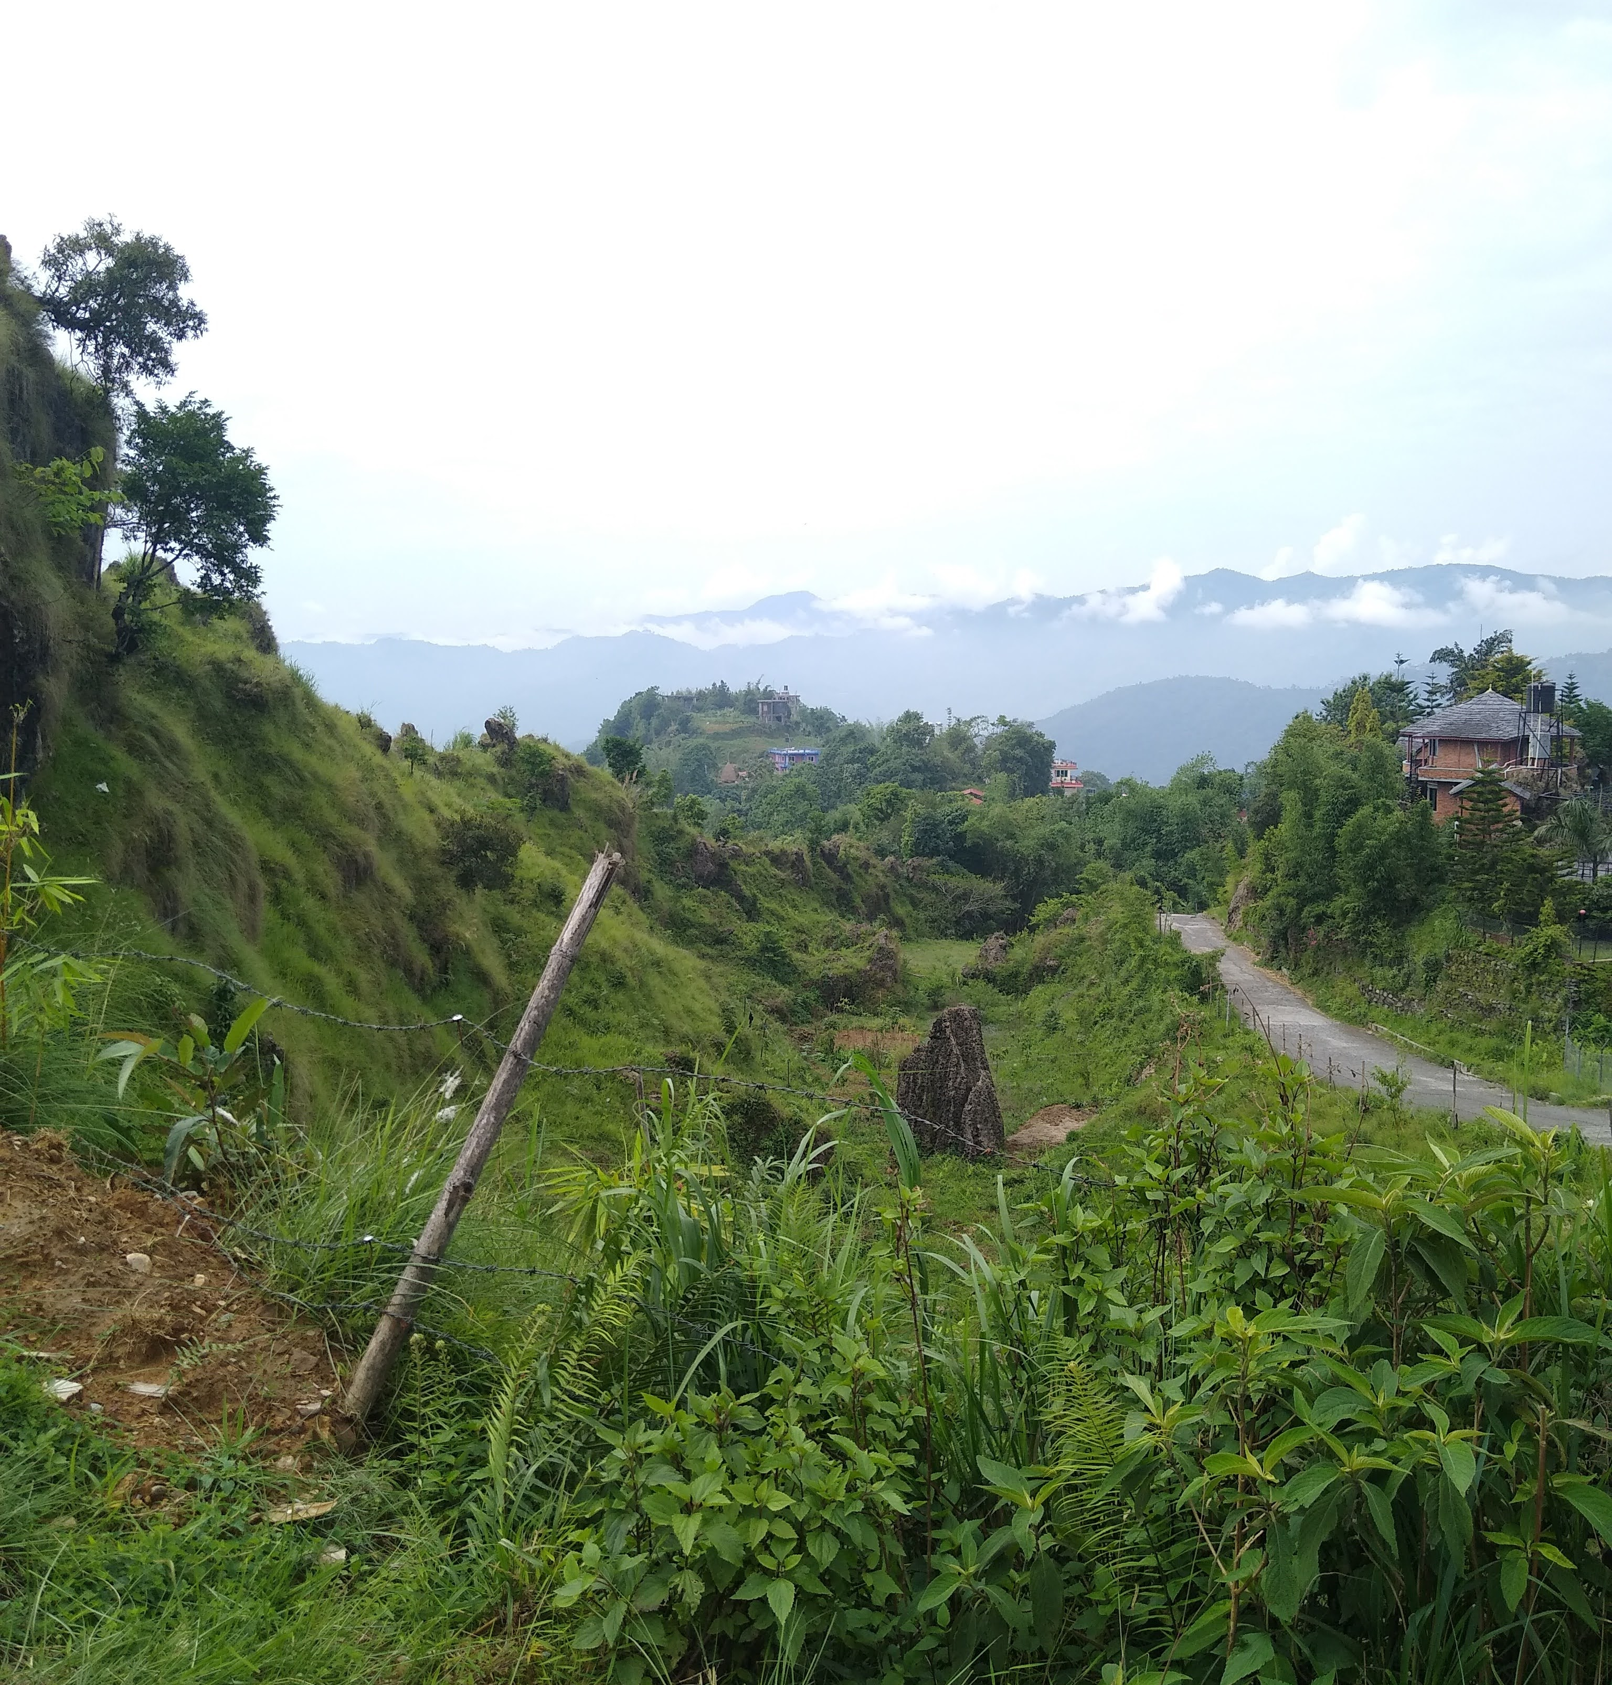
SURVEY TOPIC AREAS
Nutrition
Water, Sanitation, and Hygiene (WASH)
Agricultural Management Practices and Technologies in Select Value Chains
Women’s Empowerment in Agriculture
Resilience
Climate Adaptation
Food Insecurity
Poverty
Photo credit: USAID

Slide 6
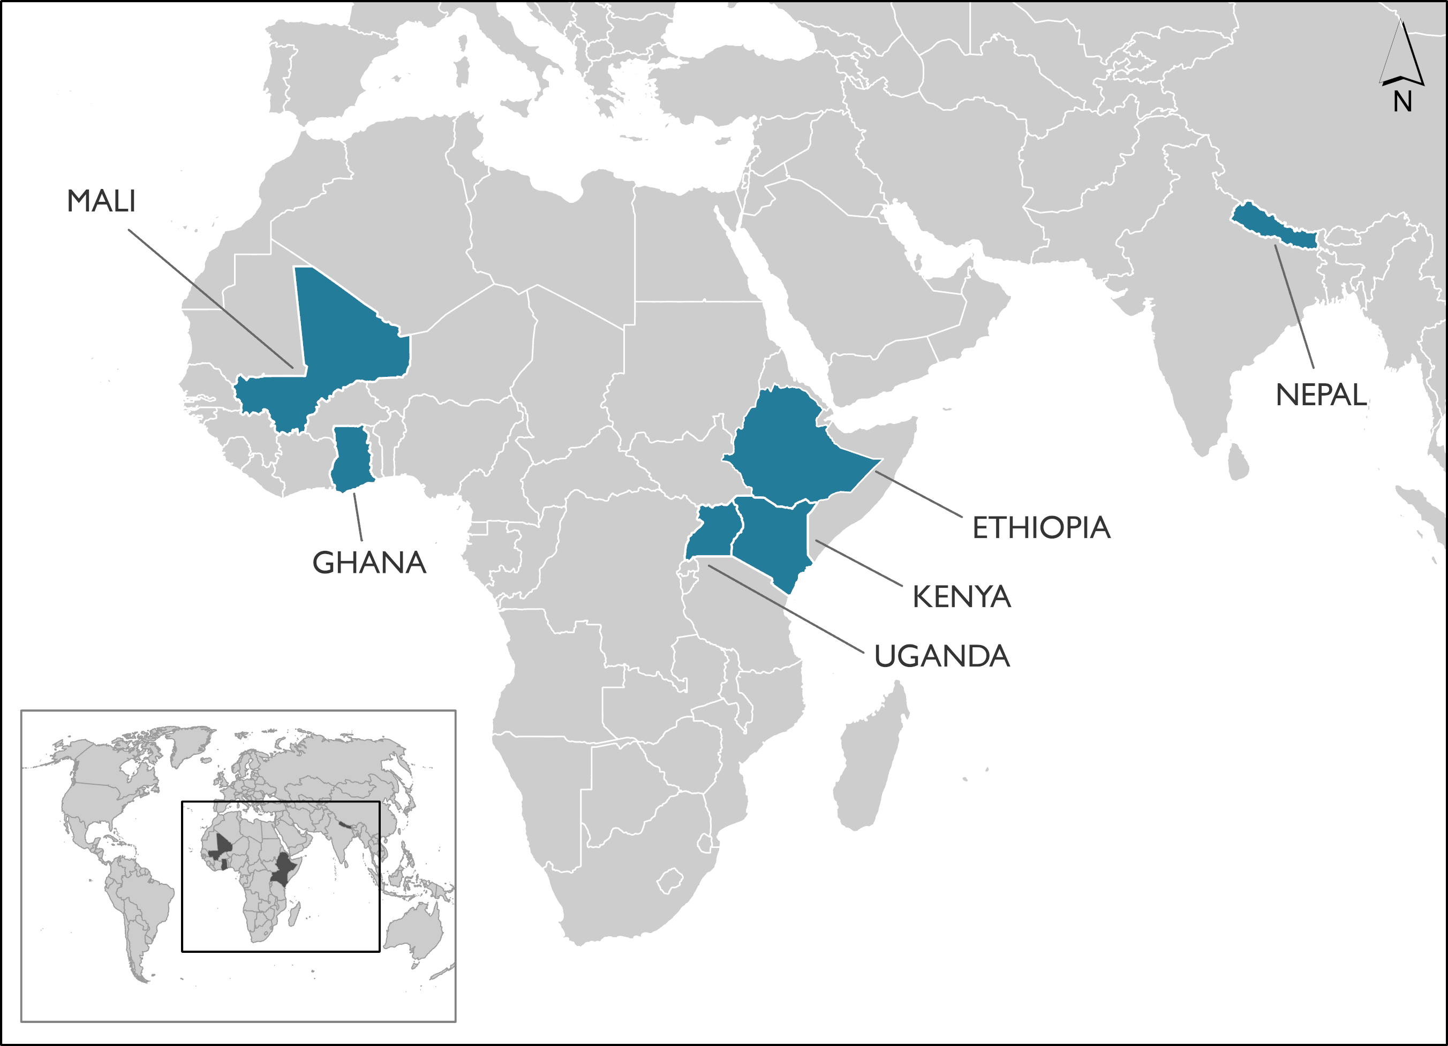
Active survey countries

Slide 7





Who we are
The SMRFS project is funded by USAID as part of Feed the Future, the U.S. Government’s global hunger and food security initiative.
The project is implemented by ICF in partnership with Blue Raster and Stattis.
Notes:
Needless to say, based on the branding of this presentation, that our project is funded by USAID.
However, what is important is which initiative of USAID funds the SMRFS project and that is FEED THE FUTURE. IN a second, we will show you a video to give a brief background about the FTF initiative to give you a perspective about what kind of data we collect for the accountability purposes like - reporting to the congress and use for adaptive management of Feed the Future programs.

Slide 8
Data Issue – parallel survey
For the housing sub-module of consumption expenditure module (Module 8), there are insufficient rental data to use conventional approach.
Nepal - only 16 households reported renting a house and 4 reported living for free.
Uganda – only 69 households reported renting a house.
Data on implicit rental values (self-reporting), that is values obtained by asking how much owners would have paid if they were renting their dwelling were not collected in the 2022 Nepal, the 2022 Uganda, or the 2022 Mali Southern Parallel Survey.
For example: If you were to reside in a similar dwelling, what would be the estimated monthly rent you are willing to pay? Or If someone wanted to rent this house, how much would they have to pay each month?
Notes:
1. World Bank (personal communication) recommends removing the housing component of the total per capita per day (PCD) consumption expenditure from both the baseline (source) and parallel survey.
2. Re-calculate poverty indicators based on the PCD total expenditure without housing expenditure.
3. Use the PCD total expenditure without housing component for S2S analysis for the target survey.

Slide 9
Data Issue – parallel survey: possible solutions
Conventional modeling approach - hedonic regression – use rent paid by renter-households as the dependent variable.
Remove housing component from the total per capita daily (PCD) consumption expenditure.
Predicting rental values for the Midline Parallel data using Baseline data.
Kriging – using geospatial coordinates to predict values.
Machine learning models – combining dwelling characteristics and geospatial coordinates.
Notes:
1. World Bank (personal communication) recommends removing the housing component of the total per capita per day (PCD) consumption expenditure from both the baseline (source) and parallel survey.
2. Re-calculate poverty indicators based on the PCD total expenditure without housing expenditure.
3. Use the PCD total expenditure without housing component for S2S analysis for the target survey.

Slide 10
Options 1 and 2 (continued …)
Option 1:
Insufficient rent data to use conventional approach – hedonic housing regression (using an econometric model) is used in most cases to predict/impute rental-values
Option 2:
Results from both the baseline and midline parallel surveys analysis after removing per capita daily housing expenditure show that poverty prevalence increased substantially (from 9.2% to 22.6% for 2019 Nepal Baseline and 2.8% to 16.6% for the 2022 Parallel survey).

Slide 11
Rationale
Housing expenditure is a relevant part of consumption aggregate in measuring poverty. Thus, housing expenditure should be included in the construction of the total consumption expenditure for poverty analysis (Balcazar, et al. 2017).
Guidelines from Deaton and Zaidi (2002) state four main approaches: self-reporting (or self-assessment), hedonic regression, rent-to-value, and user-cost methods to impute rental-value of owner-occupied dwellings.
For the ZOI surveys, we apply hedonic housing regression (using an econometric model) to predict/impute rental-values.

Slide 12
An approach to predict rental values for owner-occupied dwellings in the parallel survey

Slide 13
SMRFS Data Analysis team Approach
The ZOI surveys collect information on geospatial coordinates of households in the survey, i.e., latitude and longitude.
Household coordinates vs. cluster coordinates.
Dwellings in the same location are likely to have similar characteristics because dwellers may have similar socio-demographic characteristics.
The ICF data analysis team proposes to use machine learning models to impute rental-values of dwellings for the parallel survey of the midline.
Analysis done in R using the Simple Feature ( ‘sf’) and the caret package for the geospatial analysis and machine learning model prediction.
Utilize the geospatial coordinates and dwelling characteristics of households and imputed log rental-values of dwellings from the Baseline data as our training dataset.

Slide 14
Predicting Rental Values Step by Step
Prepare data.
Create variables on dwelling characteristics, transform rental values into log form.
Partition Baseline data into test and training datasets for cross validation.
Random splitting.
Spatial CV.
Run machine learning models – k-Nearest Neighbor (kNN), Random Forest (RF), Generalized Additive Model (GAM).
Kriging (latitude and longitude as predictors)
Full model (latitude and longitude plus dwelling characteristics).
Model selection
Run selected model with full baseline data as training dataset and midline parallel data as test dataset to predict rental values (log).

Slide 15
Additional Steps
Apply price deflators to measure inflation in the price of rents.
Use the CPI basket for non-food items (if available CPI on rents) to deflate the rents for 2022.
Merge these values to the parallel survey data.
Complete the analysis to compute the housing component of aggregate consumption expenditure.
Include house repair/maintenance expenditure.
Run outlier analysis and apply median imputation where needed.
Run the final poverty syntax to aggregate consumption expenditures calculated for each sub-module.

Slide 16
Additional steps (Continued…)
Conduct outlier analysis on the aggregate consumption expenditure in local currency unit (LCU).
Construct poverty line and calculate the desired poverty indicator.

Slide 17
Modeling to impute rental-values

Slide 18
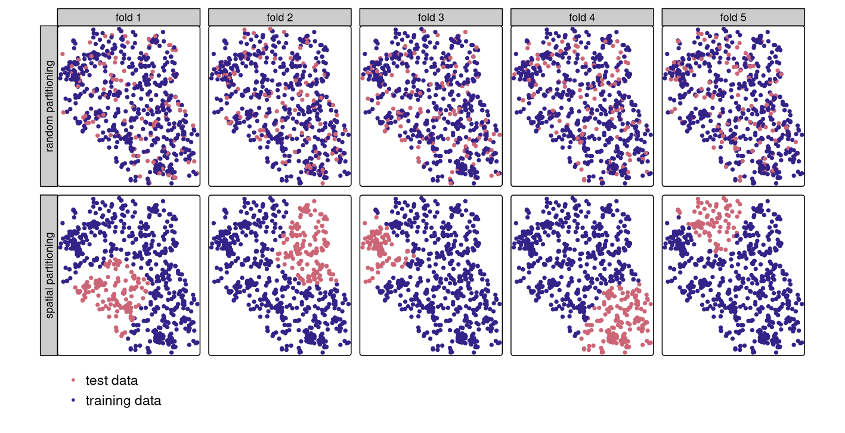
Cross Validation
Cross validation – repeatedly splitting a dataset into training and test sets whereby the training data is used to fit a model which then is applied to the test set.
Random partitioning
Splitting dataset into subsets (folds) is done at random.
Spatial partitioning
Splitting dataset into spatially disjointed subsets to avoid overfitting based on location.
Notes:
Cross validation involves separating the data into two separate subsets, in which the training data is used to inform on relationships between the independent and dependent variables. This is then tested on the test data and the overall model fit is then assessed based on the difference between the predicted and actual values.
How the dataset is split between test and training datasets is particularly important when working with spatio-temporal features. In typical cases, random or random stratified sampling can be used to select the responses that go into the test dataset. However, with spatial data,
points close to each other are, generally, more similar than points further away (Miller 2004). This means these points are not statistically independent because training and test points in conventional CV are often too close to each other (see first row of Figure 12.3). ‘Training’ observations near the ‘test’ observations can provide a kind of ‘sneak preview’: information that should be unavailable to the training dataset.
To alleviate this problem ‘spatial partitioning’ is used to split the observations into spatially disjointed subsets. In most cases, researchers use the observations’ coordinates to create a clustering assignment of each of the observations. Given that our households are assigned to enumeration areas or survey clusters, we can use these instead.
This partitioning strategy is the only difference between spatial and conventional CV. As a result, spatial CV leads to a bias-reduced assessment of a model’s predictive performance, and hence helps to avoid overfitting.
The maps displays the difference between random partitioning in the top row and spatial partitioning on the bottom. Whereas the points selected in the top are randomly distributed throughout the data, in the spatial portioning we can see each “fold” or subset is clustered together. This is to address the spatial autocorrelation problem.
This is particularly important in the context of our surveys given that the ZOI can change between survey rounds, as it did in Mali where new regions were added between baseline and midline. Such a scenario makes such a prediction task particularly susceptible to overfitting.

Slide 19
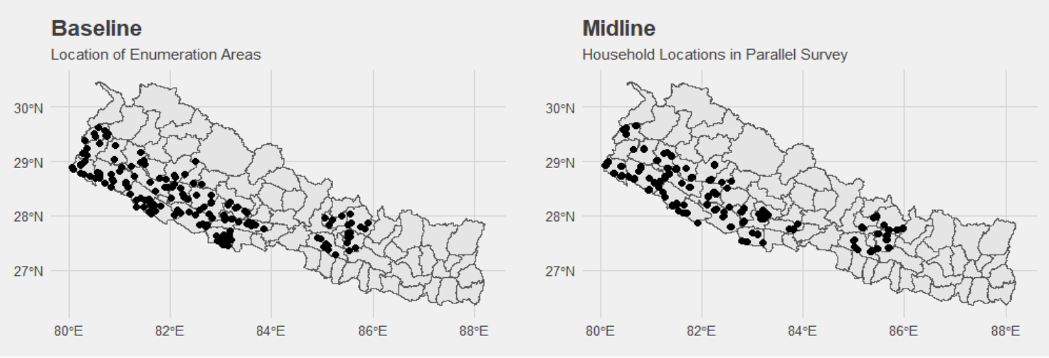
Nepal Zoi

Slide 20
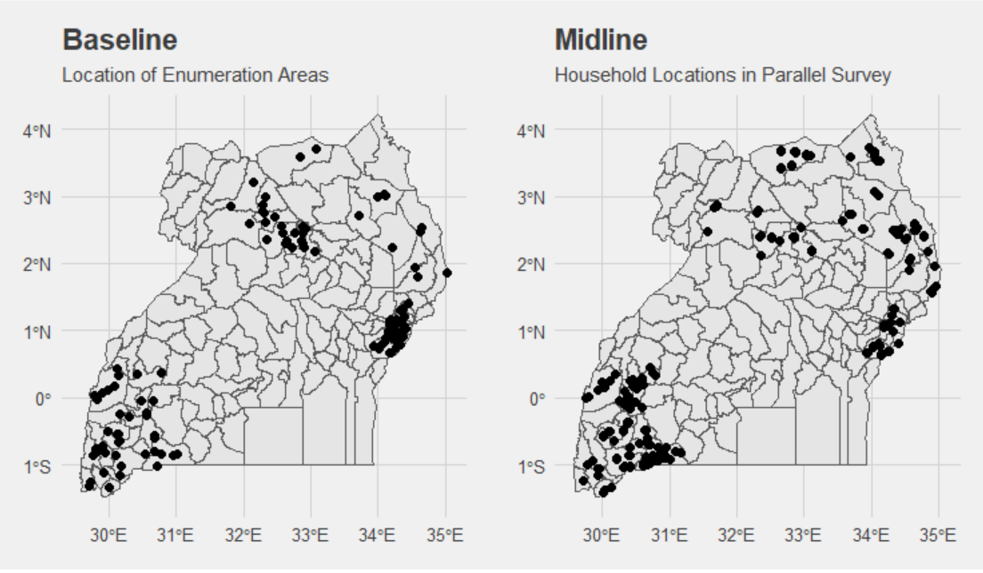
Uganda Zoi

Slide 21
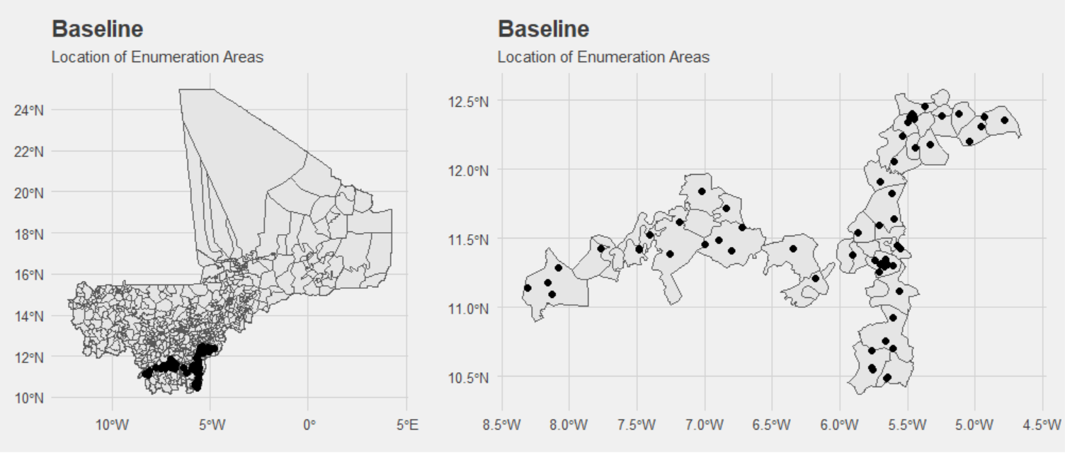
Mali ZOI

Slide 22
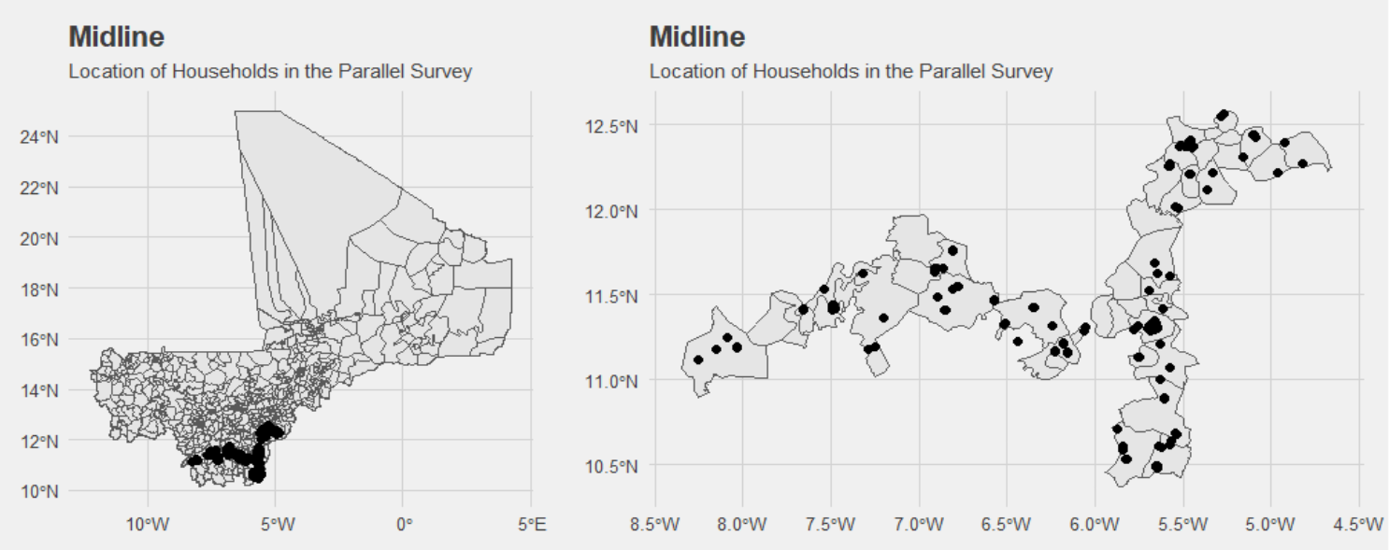
Mali ZOI

Slide 23
Machine Learning Algorithms: An Overview
K Nearest Neighbor (kNN) is a supervised machine learning algorithm that classifies new data points based on the information available of its neighboring data points. More specifically, the kNN method implies the identification of the k nearest reference samples in the space based on the Euclidean distance to predict the values for the undefined units.
Random Forest (RF) is a supervised machine learning algorithm that grows and combines multiple decision trees. It is used for both classification and regression problems. It works by building decision trees on different samples of the given dataset and taking their majority vote for classification and average for regression.
Generalized Additive Model (GAM) is a statistical modeling technique that uses smooth functions of the predictor variables to infer the values of the outcome variable. It differs from Generalized Linear Models (GLMs) because it does not assume a strict linear relationship between predictors and the outcome.
Notes:
kNN – is a supervised machine learning algorithm that classifies new data points based on the information available of its neighboring data points. In order to find its nearest neighbors, kNN models uses the information from the variables provided to create a score that is used as a distance measure that approximates the similarity between observations. This is similar to how propensity scores work. Thus, if latitude and longitude are provided, it will look for the neighbors based exclusively on physical proximity. If dwelling characteristics are provided alongside geospatial information,
It is necessary to specify the amount of nearest neighbors to use for averaging on the outcome variable. For example, if k=1 then the new data point will be assigned the value of its closest neighbor. If k is greater than 1, then it’ll be assigned the average of the k nearest neighbors.
When we run our machine learning models, we let it run on k =1 to k = 13 and assess the model performance accordingly to determine the number of neighbors to use.
Random Forest is a commonly-used machine learning algorithm that combines the output of multiple decision trees to reach a single result. Let’s break it down:
Decision Trees: These are fundamental building blocks. Imagine a decision tree as a series of questions leading to a final decision. For instance, consider a decision tree for deciding whether to go surfing:
Question 1: “Is it a long period swell?”
Question 2: “Is the wind blowing offshore?”
The answers to these questions guide you to either “surf” or “don’t surf.”
Decision trees split data based on these questions, forming branches and leaf nodes.
Ensemble Learning: Random Forest takes this concept further. It creates an ensemble of decision trees. Here’s how it works:
Bagging (Bootstrap Aggregation): First, a random sample of data from the training set is selected with replacement. Multiple decision trees are trained independently on these samples.
Averaging Predictions: For classification or regression tasks, the average or majority of predictions from these trees yield a more accurate estimate. This reduces variance in noisy datasets.
Feature Randomness: Random Forest introduces another layer—feature randomness:
It generates a random subset of features for each tree.
This ensures low correlation among decision trees.
The uncorrelated forest of decision trees forms the Random Forest model.
In summary, Random Forest leverages both bagging and feature randomness to create a robust ensemble of decision trees, resulting in accurate predictions for various tasks¹². 🌳🌲
A Generalized Additive Model (GAM) is a statistical modeling technique that extends the concept of a Generalized Linear Model (GLM). Here are the key points:
Linear Response Variable:
In a GAM, the response variable (the one we’re trying to predict) depends linearly on unknown smooth functions of some predictor variables.
These smooth functions allow for more flexibility and non-linearity compared to traditional linear models.
Focus on Smooth Functions:
The primary interest in GAMs lies in inference about these smooth functions.
Instead of assuming a strict linear relationship between predictors and the response, GAMs allow us to explore more complex patterns.
Components of a GAM:
Response Variable (Y): The variable we want to predict.
Predictor Variables (xi): These are the features or independent variables.
Exponential Family Distribution: We specify a distribution for Y (e.g., normal, binomial, or Poisson) along with a link function (e.g., identity or log).
Smooth Functions (fi): These are the unknown smooth functions of the predictor variables.
They can be parametric (e.g., polynomial) or non-parametric (simply “smooth functions”).
Non-parametric fits allow for better data fits but may sacrifice interpretability.
Theoretical Background:
The idea of representing multivariate continuous functions as sums and compositions of univariate functions dates back to the 1950s.
GAMs drop the outer sum and demand that the function belongs to a simpler class.
The function is written as f(x) = g⁻¹(θ), where g is a smooth monotonic function.
The standard formulation of a GAM relates the expectation of the observed quantity to the predictor variables.
Generality:
GAMs are quite broad, allowing for various types of smooth functions.
Examples include multivariate covariates, varying coefficients, and more.
In summary, GAMs provide a powerful framework for modeling complex relationships by incorporating smooth functions into the linear model structure

Slide 24
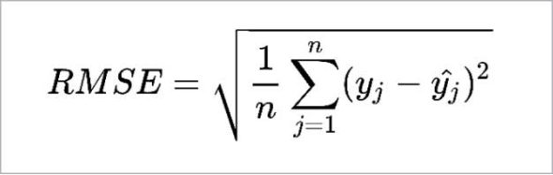
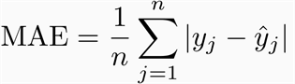
Model Selection Criteria
After we run the different statistical models, what rules do we use to select the one we will use to predict values for the parallel survey? Our focus is on metrics that tell us how accurate our predictions are and what is the amount of deviation from the actual values.
Root Mean Squared Error (RMSE) – the quadratic mean of the differences between the observed and predicted values, in which we square the differences before averaging and then take the square root.
Mean Absolute Error (MAE) – calculates the residual for every data point and takes the average of the absolute value of each so that negative and positive residuals do not cancel out.
Notes:
We use RMSE as our primary metric and MAE as our secondary metric because RMSE more heavily penalized outliers because we want our models to be more sensitive to extreme errors.
MAE:
Considers the absolute magnitude of errors.
Treats all errors equally.
Robust to outliers.
Useful when errors have equal importance.
RMSE:
Emphasizes larger errors due to squaring.
Penalizes outliers more.
Sensitive to extreme values.
Useful when larger errors are more critical.

Slide 25
Model Specification
Kriging model
log_house ~ s(latitude, longitude)
Dwelling model
log_house ~ roof + floor + acc_electricity + lat_flush + lat_pit + lat_oth + wat_pipe + wat_well + wat_surf + wat_tank +wat_bott + cook_inhouse
Full model
log_house ~ roof + floor + acc_electricity + lat_flush + lat_pit + lat_oth + wat_pipe + wat_well + wat_surf + wat_tank +wat_bott + cook_inhouse + s(latitude, longitude)
Notes:
For each country, we run a model only with the geospatial coordinates, one with the dwelling characteristics only, and a full model that combines the geospatial information and dwelling characteristics.
Dwelling characteristics:
Improved roof – iron sheets/metal (most common), wood, asbestos, tiles, concrete, roofing shingles.
Improved floor – parquet or polished wood, concrete, ceramic tile, cement screed, carpet, stones, bricks
Flush latrine
Pit latrine
Other latrine – composting toilet, bucket toilet, hanging toilet, no facility (ODF), other.
Access to electricity – yes/no
Piped water
Water well – protected, unprotected.
Surface water (river/dam/lake/pond/stream/canal/irrigation channel/rainwater).
Water from a tank – tanker truck, cart with small tank
Water (bottled)
For the geospatial coordinates, we put longitude and latitude in a spline for GAM and keep them separate for the RF and kNN models. RF models are particularly good at exploring interactions between variables and can identify the relationship between longitude and latitude as a combined set of variables automatically.

Slide 26
Model Selection
Nepal
Algorithm/Statistical Model Used | Model Specification | RMSE | MAE
kNN (k=5) | Kriging | .781 | .604
RF (mtry = 6) | Kriging | .775 | .598
GAM | Kriging | ,792 | .617
kNN (k = 13) | Dwelling only | .674 | .522
RF (mtry = 6) | Dwelling only | .676 | .524
GAM | Dwelling only | .674 | .523
kNN (k = 13) | Full | .700 | .517
RF (mtry = 6) | Full | .652 | .502
GAM | Full | .655 | .505
Notes:
For these results, we see that Nepal has some of the best metrics on the kriging models (using geospatial coordinates only). One of the possible reasons for this is because the Nepal ZOI is more straightforward than the Uganda or Mali ZOIs: all of the Baseline locations are similar to those of the Midline.
The dwelling characteristics on their own have relatively greater predictive power than the geospatial coordinates on their own. The improvement in model accuracy for each set of variables is modest for each, with the full variable random forest model having the lowest RMSE and MAE. Despite this, the RF and GAM models are very close in terms of accuracy.
K = number of neighbors used for average score.
Mtry = number of variables randomly collected to be sampled at each split time.

Slide 27
Model Selection
Uganda
Algorithm/Statistical Model Used | Model Specification | RMSE | MAE
kNN (k = 13) | Kriging | .791 | .594
RF (mtry = 4) | Kriging | .781 | .593
GAM | Kriging | .773 | .595
kNN (k = 5) | Dwelling only | .534 | .331
RF (mtry = 4) | Dwelling only | .531 | .331
GAM | Dwelling only | .532 | .330
kNN (k = 13) | Full | .546 | .358
RF (mtry = 4) | Full | .529 | .336
GAM | Full | .531 | .338
Notes:
It is surprising that the kriging models in Uganda do as well as they do in Nepal, given that the ZOI is not contiguous and broken between the Southwestern corner of Uganda and the North and East regions. However, when we look at the gain from incorporating geospatial information and dwelling characteristics in the full model, we see very little improvement. In the kNN full model, we even see a worsening of the results based on RMSE. Given the disconnected nature of the spatial features in Uganda, the kNN may not be confused by geospatial information being added into the model.

Slide 28
Model Selection
Mali
Algorithm/Statistical Model Used | Model Specification | RMSE | MAE
kNN (k=3) | Kriging | .9517 | .674
RF (mtry = 2) | Kriging | .9786 | .673
GAM | Kriging | .961 | .66
kNN (k=5) | Dwelling only | .854 | .542
RF (mtry = 4) | Dwelling only | .851 | .546
GAM | Dwelling only | .855 | .546
kNN (k = 13) | Full | .579 | .578
RF (mtry = 2) | Full | .568 | .56
GAM | Full | .571 | .571
Notes:
Looking at model selection for Mali, we can start by seeing that the kriging models have relatively poor predictive power on their own. This is in part due to the fact that the Mali baseline overall has fewer observations (1120 vs. 2100 for Nepal and 2494 for Uganda). Additionally interesting is that the full model has the most improved model performance relative to the kriging and dwelling only models for each of the algorithms.

Slide 29
Variable Importance
Nepal
Uganda
Mali
Variables | Importance
Latitude | 100.00
Longitude | 85.27
Electricity (access) | 71.67
Flush latrine | 44.33
Surface water | 29.52
Piped water | 21.93
In house cooking | 20.04
Variables | Importance
Improved floor | 100.00
Electricity (access) | 53.39
Latitude | 24.59
Longitude | 23.73
Piped water | 7.63
In house cooking | 5.04
Improved roof | 3.58
Variables | Importance
Electricity (access) | 100.00
Longitude | 51.55
Latitude | 47.84
Improved floor | 26.33
Well water | 18.66
Piped water | 16.98
Improved roof | 10.79
Notes:
Since we selected random forest models for each country, we can assess variable importance for each of the three models. For regression, the relationship between each predictor and the outcome is evaluated. In this case, a linear model is fit and the absolute value of the t-value for the slope of the predictor is used. Otherwise, a loess smoother is fit between the outcome and the predictor. The R2 statistic is calculated for this model against the intercept only null model. This number is returned as a relative measure of variable importance.
We can see that in Uganda, geospatial coordinates play a relatively less important role in predicting rental values than in Mali. This is also demonstrated in the breakdown of the different model types, where the combination of geospatial information and dwelling characteristics led to a significant improvement in predictive performance in Mali whereas there was very little impact in Uganda.
In general, the random forest model for Uganda places very high importance on two variables – improved floor and access to electricity - and less for all others. In all models, we can observe that access to electricity is an important determinant in rental values for all countries.
Finally, Nepal has the highest importance for the geospatial information. An important reason for this is that there is less variance between households on the dwelling characteristics used in our models in Nepal compared to Uganda or Mali, thereby leaving this set of covariates with less predictive power. For comparison in our baseline data, 91% of households (unweighted) in Nepal have an improved floor, compared to 29% in Uganda and 58.5% in Mali (unweighted). Households in the Nepal ZOI are at a different level of development, and different variables on dwelling characteristics may need to be considered because of it.

Slide 30
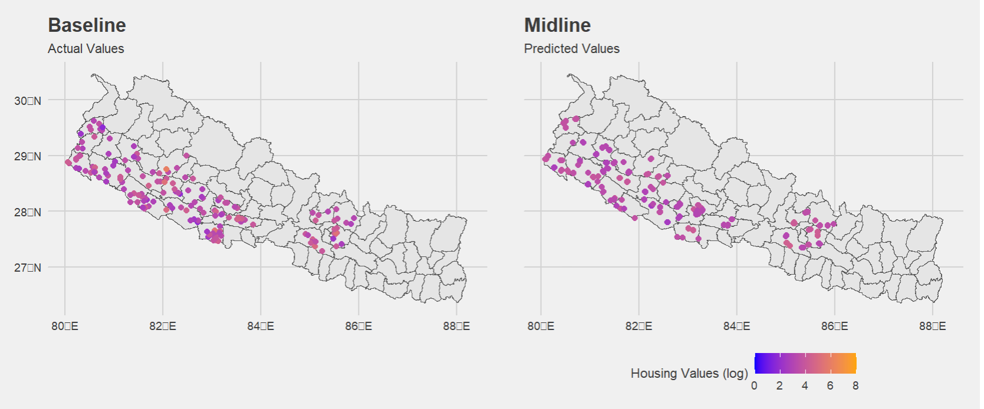
Nepal – Rental Values
Notes:
Visualizing the map of predicted rental values in the case of Nepal shows how geographic location in this particular case is a powerful predictor. In areas of the map of the baseline where rental values are higher (in orange), we see higher values (orange) for the predicted values of households in similar locations for the Midline.

Slide 31
Takeaways and Next Steps
There is predictive power in combining both geospatial information and dwelling characteristics to predict rental values when data is missing or unavailable.
Nepal and Mali – relatively higher importance of geospatial information.
Uganda – relatively greater importance of dwelling characteristics.
Random forest models seem to have the best performance for predicting rental values for these types of models.
Notes:
Combining geospatial information and dwelling characteristics make for the most robust models in all three cases.
Use of geospatial coordinates to predict rental values worked best in Nepal and Mali. Although the geospatial coordinates in Uganda had limited predictive power, the use of dwelling characteristics combined with geospatial information gave robust modeling outputs.
This speaks to the geographic features of the ZOI. The more contiguous the ZOI is, the better spatial modeling works for predicting rental values.
Random forests are particularly well suited for identifying and exploring interactions between variables and using them to predict outcomes – they are also well suited for using geospatial information combined with other information such as variables related to dwelling characteristics. GAM and kNN models do not have this advantage.

Slide 32
Next Steps
Analysis for Kenya, Ethiopia, and Ghana surveys.
In future surveys, we will ask owners for how much they would rent their house. We can compare these responses to the predicted rental values used in this approach.
Comparing with other machine learning models, traditional hedonic regression and geographically weighted regression models.
Obtaining household coordinates for Baseline data to see if prediction improves compared to using coordinates of enumeration areas/clusters.

Slide 33
References
Balcázar CF, Ceriani L, Olivieri S, Ranzani M. (2017). Rent-Imputation for Welfare Measurement: A Review of Methodologies and Empirical Findings. Review of Income and Wealth. 63(4):881–98. DOI: 10.1111/roiw.12312.
Deaton A, Zaidi S. Guidelines for Constructing Consumption Aggregates For Welfare Analysis. World Bank. 2002;1–107.
Embaye WT, Zereyesus YA, Chen B (2021) Predicting the rental value of houses in household surveys in Tanzania, Uganda and Malawi: Evaluations of hedonic pricing and machine learning approaches. PLOS ONE 16(2): e0244953. https://doi.org/10.1371/journal.pone.0244953
Weinberger KQ, Saul LK. Distance metric learning for large margin nearest neighbor classification. The Journal of Machine Learning Research 2009;10:207-44.
Hechenbichler K. and Schliep K.P. (2004) Weighted k-Nearest-Neighbor Techniques and Ordinal Classification, Discussion Paper 399, SFB 386, Ludwig-Maximilians University Munich. https://epub.ub.uni-muenchen.de/1769/1/paper_399.pdf
Lovelace, R., Nowosad, J., Muenchow, J. (2019). The R Series: Geocomputation with R. CRC Press. Link: geocompx.org

Slide 34
asdfkjhaskjdfh

